Slide 1
Lecture 7: Logistic Regression
Instructor: Xiaobai Liu

Slide 2
Recap: Linear Regression
Linear Regression for single feature
Cost function: residual square of sum
Gradient Descent Method
Best Practices

Slide 3
Today’s meeting
Logistic regression
GD method
Practices

Slide 4
Binary Classification Problems
Examples:
Housing Price → real value
Spam Email detection → spam or normal
Fish classification → sea bass or salmon

Slide 5
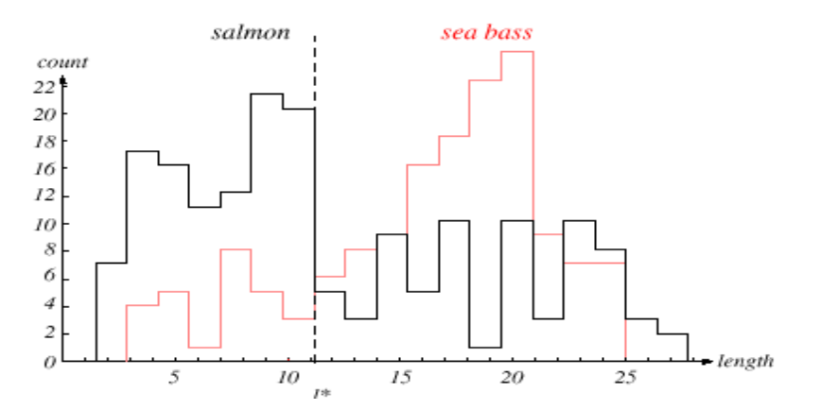
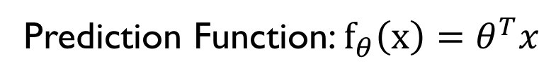
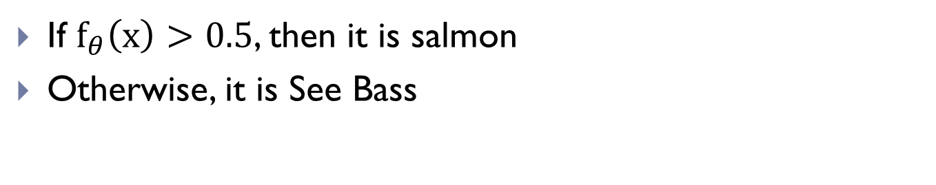
Regression for Fish Classification
1
0
length
Prediction Function: $f_{θ}\left(x\right)=θ^{T}x$
If $f_{θ}\left(x\right)>0.5$, then it is salmon
Otherwise, it is See Bass

Slide 6
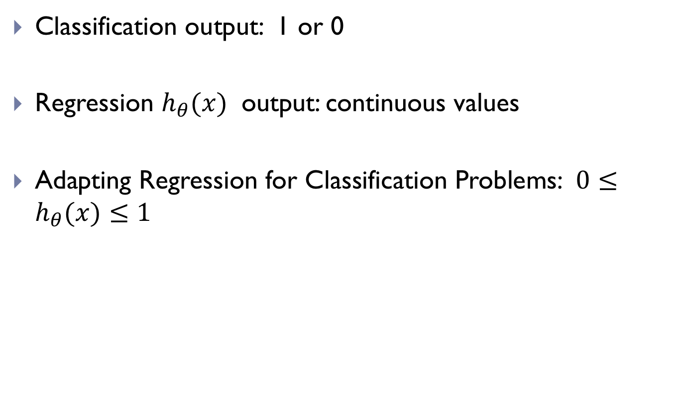
Classification vs Regression
Classification output: 1 or 0
Regression $h_{θ}(x)$ output: continuous values
Adapting Regression for Classification Problems: $0≤h_{θ}(x)≤1$

Slide 7

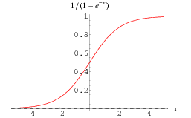
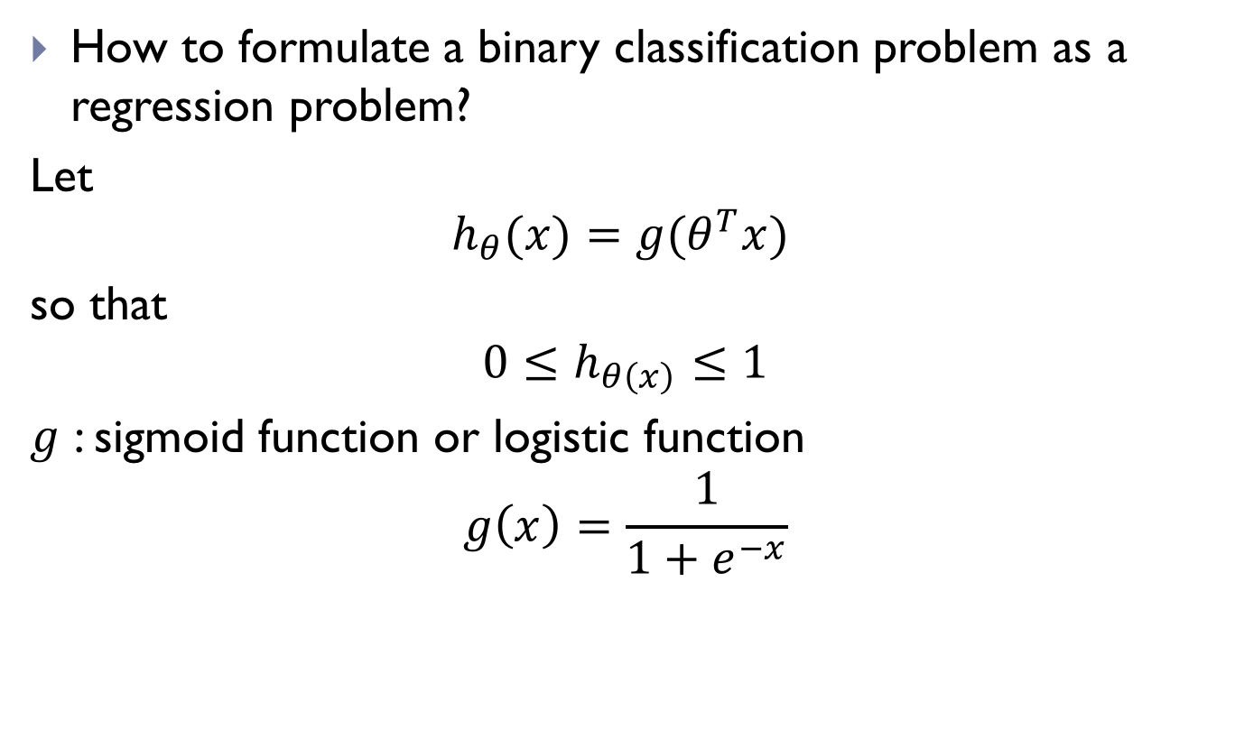
Logistic Regression
How to formulate a binary classification problem as a regression problem?
Let
$${h_{θ}(x)=g(θ}^{T}x)$$
so that
$${0≤h}_{θ\left(x\right)}≤1$$
$g$ : sigmoid function or logistic function
$$g\left(x\right)=\frac{1}{1+e^{−x}}$$

Slide 8


Understanding: $h_{θ}(x)$
$h_{θ}(x)$ is the estimated probability that output is 1 on input x
E.g. If $h_{θ}(x)$=0.7, then the fish is sea bass at a probability of 0.7

Slide 9

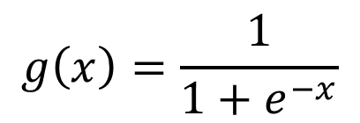


Understanding: $h_{θ}(x)$
$${h_{θ}(x)=g(θ}^{T}x)$$
$$g\left(x\right)=\frac{1}{1+e^{−x}}$$
If $θ^{T}x≥0$, then $g\left(θ^{T}x\right)≥0.5$, and it is likely to be y=1
If $θ^{T}x≤0$, then $g\left(θ^{T}x\right)≤0.5$, and it is likely to be y=0
Notes:
(>=0)
(<=0)

Slide 10
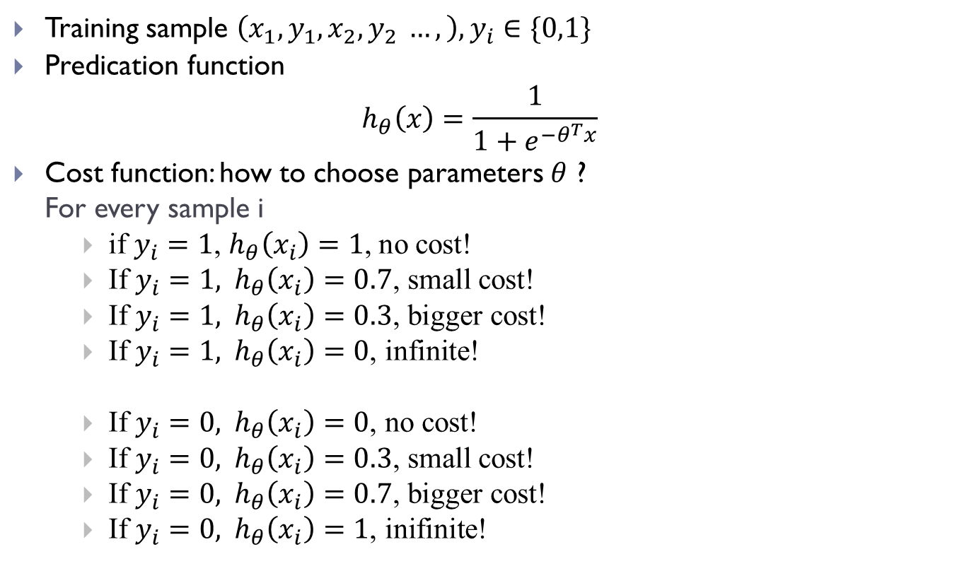
Learning of logistic regression
Training sample $\left(x_{1},y_{1}, x_{2},y_{2} …,\right), y_{i}∈\{0,1\}$
Predication function
$$h_{θ}\left(x\right)=\frac{1}{1+e^{−θ^{T}x}}$$
Cost function: how to choose parameters $θ$ ?
For every sample i
if $y_{i}=1$, $h_{θ}\left(x_{i}\right)=1$, no cost!
If $y_{i}=1, h_{θ}\left(x_{i}\right)=0.\text{7}\text{, }\text{small} \text{cost}\text{!}$
If $y_{i}=1, h_{θ}\left(x_{i}\right)=0.\text{3}\text{, }\text{bigger} \text{cost}\text{!}$
If $y_{i}=1, h_{θ}\left(x_{i}\right)=0\text{, }\text{infinite}\text{!}$
If $y_{i}=0, h_{θ}\left(x_{i}\right)=0\text{, }\text{no} \text{cost}\text{!}$
If $y_{i}=0, h_{θ}\left(x_{i}\right)=0.3\text{, }\text{small} \text{cost}\text{!}$
If $y_{i}=0, h_{θ}\left(x_{i}\right)=0.7\text{, }\text{bigger} \text{cost}\text{!}$
If $y_{i}=0, h_{θ}\left(x_{i}\right)=1\text{, }\text{inifinite}\text{!}$

Slide 11

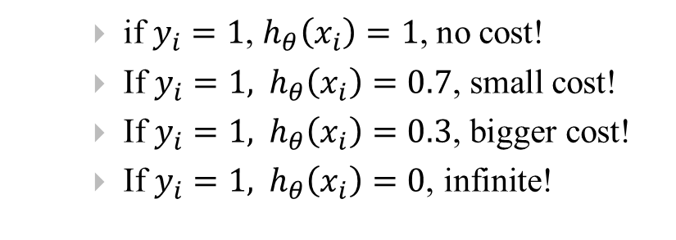



Magic function I
if $y_{i}=1$, $h_{θ}\left(x_{i}\right)=1$, no cost!
If $y_{i}=1, h_{θ}\left(x_{i}\right)=0.\text{7}\text{, }\text{small} \text{cost}\text{!}$
If $y_{i}=1, h_{θ}\left(x_{i}\right)=0.\text{3}\text{, }\text{bigger} \text{cost}\text{!}$
If $y_{i}=1, h_{θ}\left(x_{i}\right)=0\text{, }\text{infinite}\text{!}$
-log(a)
$$0$$
$$0.3$$
$$0.7$$
$$1$$

Slide 12

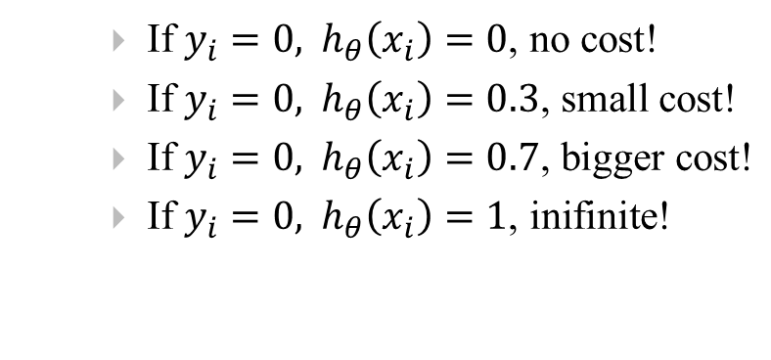



Magic function II
If $y_{i}=0, h_{θ}\left(x_{i}\right)=0\text{, }\text{no} \text{cost}\text{!}$
If $y_{i}=0, h_{θ}\left(x_{i}\right)=0.3\text{, }\text{small} \text{cost}\text{!}$
If $y_{i}=0, h_{θ}\left(x_{i}\right)=0.7\text{, }\text{bigger} \text{cost}\text{!}$
If $y_{i}=0, h_{θ}\left(x_{i}\right)=1\text{, }\text{inifinite}\text{!}$
-log(1-a)
$$0$$
$$0.3$$
$$0.7$$
$$1$$

Slide 13
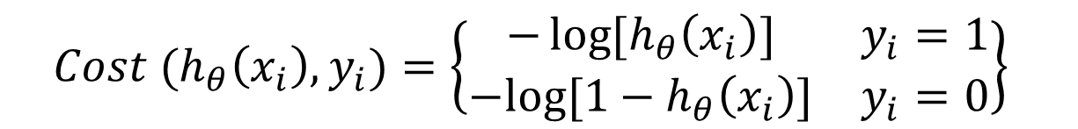

Cost Function for Logistic Regression
Training sample $\left(x_{1},y_{1}, x_{2},y_{2} …,\right), y_{i}∈\{0,1\}$
Predication function
$$h_{θ}\left(x\right)=\frac{1}{1+e^{−θ^{T}x}}$$
Cost function:
$${Cost (h}_{θ}\left(x_{i}\right), y_{i})=\left\{\begin{matrix}−\log{{[h}_{θ}\left(x_{i}\right)}] & y_{i}=1 \\ −log⁡[1−h_{θ}\left(x_{i}\right)] & y_{i}=0\end{matrix}\right\}$$

Slide 14
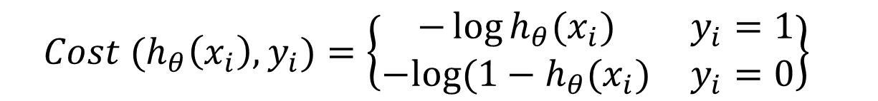
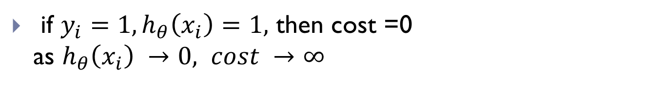
Understanding Cost function
$${Cost (h}_{θ}\left(x_{i}\right), y_{i})=\left\{\begin{matrix}−\log{h_{θ}(x_{i})} & y_{i}=1 \\ −log⁡(1−h_{θ}(x_{i}) & y_{i}=0\end{matrix}\right\}$$
if $y_{i}=1, h_{θ}\left(x_{i}\right)=1,$ then cost =0 as $h_{θ}\left(x_{i}\right) →0, cost →∞$
-log(a)

Slide 15
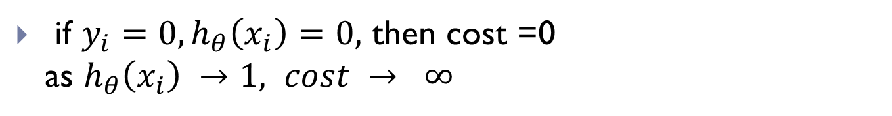
Understanding Cost function
$${Cost (h}_{θ}\left(x_{i}\right), y_{i})=\left\{\begin{matrix}−\log{h_{θ}(x_{i})} & y_{i}=1 \\ −log⁡(1−h_{θ}(x_{i}) & y_{i}=0\end{matrix}\right\}$$
if $y_{i}=0, h_{θ}\left(x_{i}\right)=0,$ then cost =0 as $h_{θ}\left(x_{i}\right) →1, cost → ∞$
-log(1-a)

Slide 16
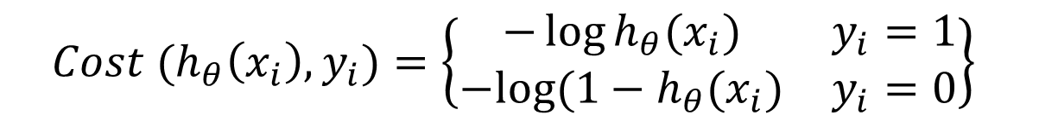

Compact Cost Function
$${Cost (h}_{θ}\left(x_{i}\right), y_{i})=\left\{\begin{matrix}−\log{h_{θ}(x_{i})} & y_{i}=1 \\ −log⁡(1−h_{θ}(x_{i}) & y_{i}=0\end{matrix}\right\}$$
equal to
$$F\left(θ\right)=−\frac{1}{m}\left(\sum_{i}{y_{i} log h_{θ}\left(x_{i}\right)+\left(1−y_{i}\right)log⁡(1−h_{θ}(x_{i})}\right)$$

Slide 17
Today’s meeting
Logistic regression
GD method
Practices

Slide 18


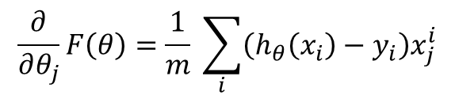
Gradient Descent
Sigmoid function y(x) has derivative:
$$\frac{dy}{dx}=\left[1−y\left(x\right)\right]y\left(x\right)$$
Repeat {
$$θ_{j}=θ_{j}−α \frac{∂}{∂θ_{j}}F(θ)$$
}
Derivative of Cost function
$$F\left(θ\right)=−\frac{1}{m}\left(\sum_{i}{y_{i} log h_{θ}\left(x_{i}\right)+\left(1−y_{i}\right)log⁡(1−h_{θ}\left(x_{i}\right))}\right)$$
$$\frac{∂}{∂θ_{j}}F\left(θ\right)=\frac{1}{m} \sum_{i}{\left(h_{θ}\left(x_{i}\right)−y_{i}\right)x_{j}^{i}}$$
Identical format as Liner Regression

Slide 19
Python implementation
File structure
data.csv: data file
main_logit.py: main entrance
util.py: functions

Slide 20
Data Set
Data:
Features: Two scores
Labels: admitted, not admitted
grade1 | grade2 | label;;;;
34.62366 | 78.02469282 | 0;;;;
30.28671 | 43.89499752 | 0;;;;
35.84741 | 72.90219803 | 0;;;;
60.1826 | 86.3085521 | 1;;;;
79.03274 | 75.34437644 | 1;;;;
45.08328 | 56.31637178 | 0;;;;
61.10666 | 96.51142588 | 1;;;;
75.02475 | 46.55401354 | 1;;;;
76.09879 | 87.42056972 | 1;;;;
84.43282 | 43.53339331 | 1;;;;

Slide 21
Main step
Data processing
Data splitting
Method 1: Training and testing (sklearn)
Method 2: training and testing (own codes)
Comparing two methods

Slide 22
Step 1: data processing
Scale all data to be between -1 and 1
min_max_scaler = preprocessing.MinMaxScaler(feature_range=(-1,1))
df = pd.read_csv("data.csv", header=0)
df.columns = ["grade1","grade2","label"]
x = df["label"].map(lambda x: float(x.rstrip(';')))
X = df[["grade1","grade2"]]
X = np.array(X)
X = min_max_scaler.fit_transform(X)
Y = df["label"].map(lambda x: float(x.rstrip(';')))
Y = np.array(Y)

Slide 23
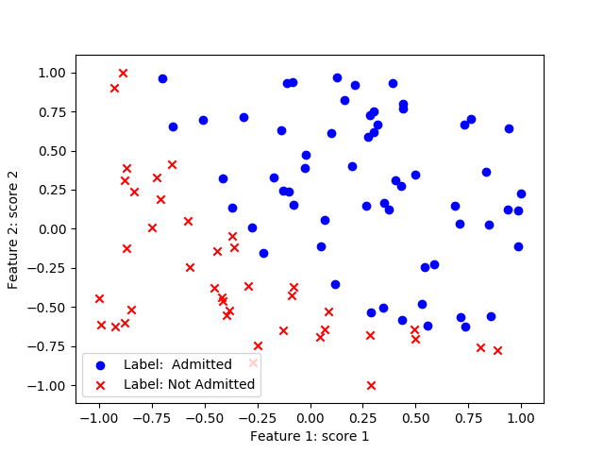
Step 1: data processing
Scale all data to be between -1 and 1

Slide 24
Step 2: data splitting
Split the dataset into testing and training subsets
X_train,X_test,Y_train,Y_test = train_test_split(X,Y,test_size=0.33)

Slide 25
Step 3: using sklearn (method 1)
Using sklearn class for training and testing logistic regression models
clf = LogisticRegression() # class instance
clf.fit(X_train,Y_train) # train
print 'score Scikit learn: ', clf.score(X_test,Y_test)

Slide 26
Step 4: using own method (method 2)
Solver: Gradient descent method, implemented in a separate function Gradient_Descent()
theta = [0,0] #initial model parameters
alpha = 0.1 # learning rates
max_iteration = 1000 # maximal iterations
m = len(Y) # number of samples
for x in xrange(max_iteration):
new_theta = Gradient_Descent(X,Y,theta,m,alpha)
theta = new_theta
if x % 200 == 0:
# calculate the cost function with the present theta
Cost_Function(X,Y,theta,m)

Slide 27
Step 4: using own method (method 2)
Functions in util.py
Sigmoid(s)
Prediction (theta, x)
Cost_function(X,Y, theta, m)
Cost_Function_Derivative (X,Y,theta,j,m,alpha)
Gradient_Descent(X,Y,theta,m,alpha)

Slide 28
Step 4: using own method (method 2)
Implementation of sigmoid function
def Sigmoid(x):
g = float(1.0 / float((1.0 + math.exp(-1.0*x))))
return g

Slide 29
Step 4: using own method (method 2)
Implementation of prediction function
def Prediction(theta, x):
z = 0
for i in xrange(len(theta)):
z += x[i]*theta[i]
return Sigmoid(z)

Slide 30
Step 4: using own method (method 2)
Implementation of cost function
def Cost_Function(X,Y,theta,m):
sumOfErrors = 0
for i in xrange(m):
xi = X[i]
est_yi = Prediction(theta,xi)
if Y[i] == 1:
error = Y[i] * math.log(est_yi)
elif Y[i] == 0:
error = (1-Y[i]) * math.log(1-est_yi)
sumOfErrors += error
const = -1/m
J = const * sumOfErrors
return J

Slide 31
Step 4: using own method (method 2)
Derivative of cost function
def Cost_Function_Derivative(X,Y,theta,j,m,alpha):
sumErrors = 0
for i in xrange(m):
xi = X[i]
xij = xi[j]
hi = Prediction(theta,X[i])
error = (hi - Y[i])*xij
sumErrors += error
m = len(Y)
constant = float(alpha)/float(m)
J = constant * sumErrors
return J

Slide 32
Step 4: using own method (method 2)
Gradient Descent Function
def Gradient_Descent(X,Y,theta,m,alpha):
new_theta = []
constant = alpha/m
for j in xrange(len(theta)):
deltaF = Cost_Function_Derivative(X,Y,theta,j,m,alpha)
new_theta_value = theta[j] - deltaF
new_theta.append(new_theta_value)
return new_theta

Slide 33
Step 5: comparing two methods
Gradient Descent Function
score = 0
winner = ""
# accuracy for sklearn
scikit_score = clf.score(X_test,Y_test)
length = len(X_test)
for i in xrange(length):
prediction = round(Prediction(X_test[i],theta))
answer = Y_test[i]
if prediction == answer:
score += 1
my_score = float(score) / float(length)
if my_score > scikit_score:
print 'You won!'
else:
print 'Scikit won.. :('

Slide 34
Today’s meeting
Logistic regression
GD method
Practices

Slide 35
Today’s meeting
Logistic regression
GD method
Practices

Slide 36
Practice1: nonlinear Transformation
Sigmoid function
Other choice: Tangent

Slide 37
Practice 2: multi-class problems
Email → spam, work, friends, family
Whether → sunny, cloudy, rain, snow
Fish → sea bass, salmon,

Slide 38

Practice: one-vs-all
For each class I, train a logistic regression classifier
$h_{θ}^{i}(x)$
For a new input x, classify it using the following :
$$\max_{i}{h_{θ}^{i}(x)}$$

Slide 39
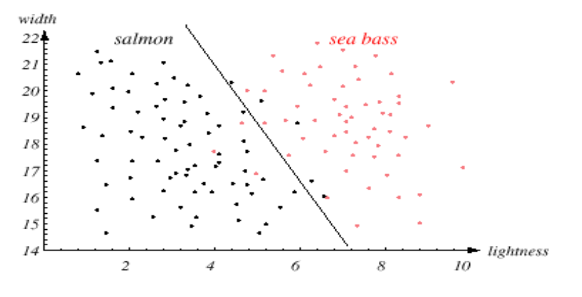
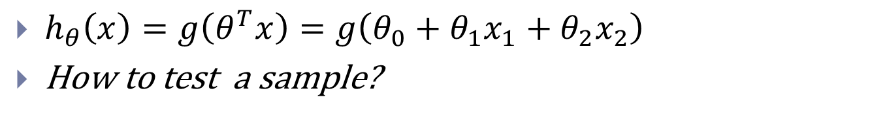

Practice 3: Decision Boundary $h_{θ}\left(x\right)$
$h_{θ}\left(x\right)=g\left(θ^{T}x\right)=g\left(θ_{0}+θ_{1}x_{1}+θ_{2}x_{2}\right)$
How to test a sample?

Slide 40
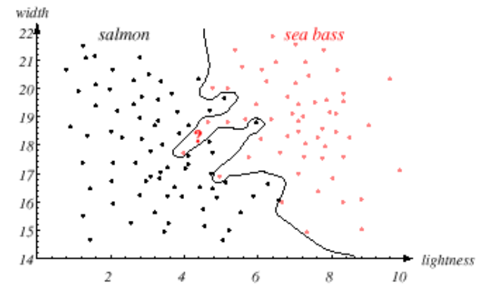
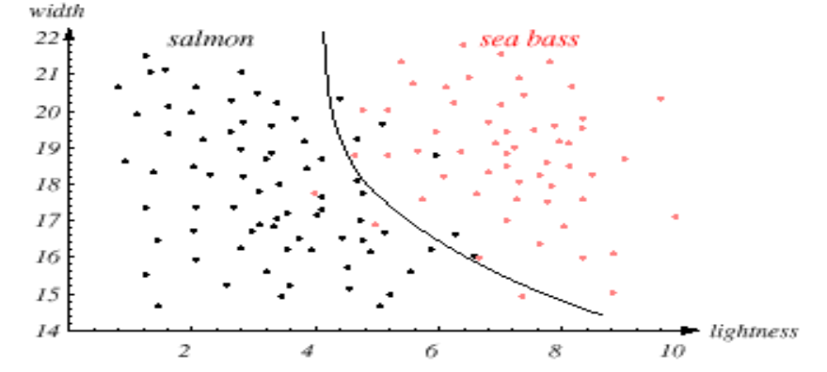

Practice 4: Nonlinear Boundary
Polynomial regression
$$\left(θ^{T}x\right)=\left(θ_{0}+θ_{1}x_{1}+θ_{2}x_{1}^{2}\right)$$
$$\left(θ^{T}x\right)=\left(θ_{0}+θ_{1}x_{1}+θ_{2}x_{1}^{2}+θ_{3}x_{1}^{3}+..\right)$$

Slide 41
The derivatives of a logistic neuron
because

Slide 42
Review
Logistic Regression solves classification problems
Gradient Descent Method
Practices

